Slide 1
ECMAScript 6
node/browser
week 2
Notes:
https://codeburst.io/es6-tutorial-for-beginners-5f3c4e7960be

Slide 2
Overview
New ECMAScript 6 constructs
Node

Slide 3
ECMAScript 6
Or: ES6, ECMAScript 2015

Slide 4
Overview
Finalized on June 2015
Adds significant new syntax constructs
Browser support is not complete
Can be transpiled back to ES5
Notes:
Transpile = little less than compiling.

Slide 5
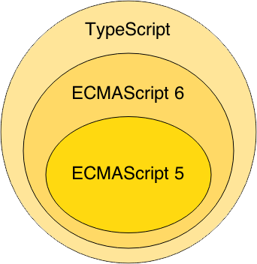
ES6
ES6 superset of ES5
Transpile ES6 to ES5
Notes:
`Wat zijn de voordelen van typescript

Slide 6
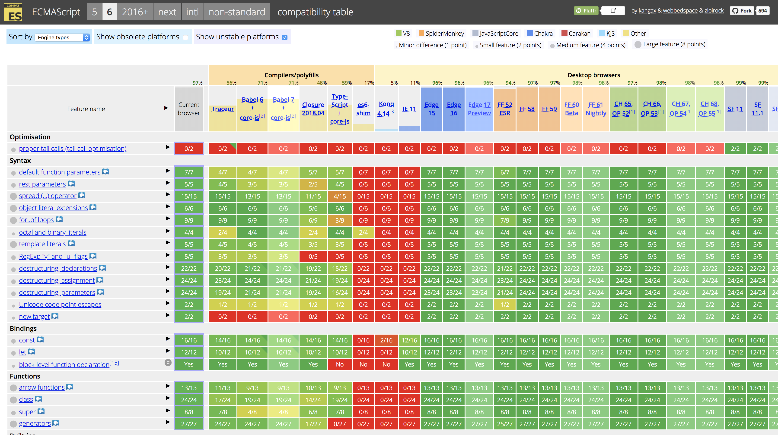
ES6 Support
http://kangax.github.io/compat-table/es6/

Slide 7
Let’s dive into it!

Slide 8
Variables
No need for “var” anymore

Slide 9
Variables
Block scoped instead of function scoped
const
let
Notes:
Hoisting: is make a variable available everywhere within a function.
const: variable can’t be assigned again vs var
let: variable can be assigned again vs var

Slide 10
Example
function() {
console.log(x); // Uncaught ReferenceError: x is not defined
if (true) {
let x = "test";
}
}
Notes:
In ECMAScript < 6, hoisting would come in place and this code would have run (given that let was var)

Slide 11
Example
function() {
const x = "x";
x = "something else";
// Uncaught TypeError: Assignment to constant variable.
const y = {y: 'y'};
y.y = 'x'; // this works
}
Notes:
‘const’ works only one level deep.
Object.freeze
The Object.freeze() method freezes an object: that is, prevents new properties from being added to it; prevents existing properties from being removed; and prevents existing properties, or their enumerability, configurability, or writability, from being changed, it also prevents the prototype from being changed. The method returns the passed object.

Slide 12
Arrow functions
lambda’s, anonymous inner classes

Slide 13
Arrow functions
// Old Syntax function oldOne() { console.log("Hello World..!"); }
// New Syntax
var newOne = () => { console.log("Hello World..!"); }

Slide 14
Arrow functions
There are two parts of the syntax.
var newOne = ()
2. => {}
Notes:
The first part is just declaring a variable and assigning the function (i.e) () to it. It just says the variable is actually a function.
Then the second part is declaring the body part of the function. The arrow part with the curly braces defines the body part.

Slide 15
Arrow functions
evens = {2,4,6,8,10}
odds = evens.map(v => v + 1)
pairs = evens.map(v => ({ even: v, odd: v + 1 }))
nums = evens.map((v, i) => { return v + i;})
Instead of:
odds = evens.map(function (v) { return v + 1; });
pairs = evens.map(function (v) { return { even: v, odd: v + 1 }; });
nums = evens.map(function (v, i) { return v + i; });

Slide 16
Arrow functions
Work the same as Java 8 lambda’s Except for:
Function is not bound to interface implementation
Arrow head is -> instead of =>

Slide 17
Arrow functions
function Person(){
this.age = 0;
setInterval(() => {
this.age++; // |this| properly refers to the person object
}, 1000);
}
var p = new Person();

Slide 18
Default parameter values
let increment = (test = 1) => test + 1;
increment(2); // 3
increment(); // 2
increment(undefined); // 2
Notes:
// or
(test = 1) = means that 1 will be the default value if no parameter.
You could also just make a function:
let bicrement = function(test = 2) { return test + 2;}

Slide 19
Spread attributes/Rest parameter
function f (x, y, ...a) {
return (x + y) * a.length
}
f(1, 2, "hello", true, 7) === 9
Must be the last parameter just like Java

Slide 20
String interpolation/Template literals
var x = `testing ${1 + 1}`
let y = `hello world ${x}`
instead of:
var x = “testing” + (1 + 1)

Slide 21
Enhanced Object properties
const x = 2, y = 3;
let obj = { x, y };
// is equivalent to:
let obj = { x: x, y: y };

Slide 22
Enhanced Object properties
// Computed property names
var prop = 'foo';
var o = {
[prop]: 'hey',
['b' + 'ar']: 'there'
};

Slide 23
Destructuring Assignment
// Arrays
[a, b, ...rest] = [1, 2, 3, 4, 5];
console.log(a); // 1
console.log(b); // 2
console.log(rest); // [3, 4, 5]
// Objects
({a, b} = {a:1, b:2});
console.log(a); // 1
console.log(b); // 2
Notes:
MDN: The destructuring assignment syntax is a JavaScript expression that makes it possible to extract data from arrays or objects into distinct variables.

Slide 24
Modules
//------ lib.js ------
export const sqrt = Math.sqrt;
export function square(x) { return x * x; }
export function diag(x, y) { return sqrt(square(x) + square(y)); }
//------ main.js ------
import { square, diag } from 'lib';
console.log(square(11)); // 121
console.log(diag(4, 3)); // 5
Notes:
export compare to public in Java .
http://2ality.com/2014/09/es6-modules-final.html

Slide 25
Modules
Node supports this feature
This is not supported in browsers yet
Transpiling helps
http://2ality.com/2014/09/es6-modules-final.html

Slide 26
Classes
class Shape {
constructor (id, x, y) {
this.id = id;
this.x = x; this.y = y;
}
size () {
return this.x * this.y;
}
}
let square = new Shape('test', 3, 3)
square.size();

Slide 27
Classes
class Square extends Shape {
constructor (id, length) {
super(id, length, length);
}
}
new Square('test', 3).size();

Slide 28
Classes
class Square extends Shape {
constructor (id, x) {
super(id, x, x);
}
static calcSize(length) {
return length * length;
}
}
Square.calcSize(3);

Slide 29
Promises
Can be compared to Java’s “Future” class
Handy for handling async operations
Helps escaping callback hell

Slide 30
Promises
let asyncFunc = () => {
return new Promise( resolve => {
setTimeout(() => resolve(42), 200);
}
}
asyncFunc.then(result => console.log(result));

Slide 31
Promises
let asyncFunc = () =>
new Promise( (resolve, error) => {
setTimeout(() => error(new Error(‘help’)), 20);
})
asyncFunc()
.then(result => console.log(result))
.catch(err => console.error(err));

Slide 32
Map
var newMap = new Map(); newMap.set('name', 'John'); newMap.set('id', 2345796); newMap.set('interest', ['js', 'ruby', 'python']);
newMap.get('name'); // John newMap.get('id'); // 2345796 newMap.get('interest'); // ['js', 'ruby', 'python']

Slide 33
Set
var set = new Set(); set.set('name', 'John'); set.set('name', 'Andy'); set.set(1, 'number one'); set.set(NaN, 'No value');
set.get('name'); // Andy. Note John is replaced by Andy. set.get(1); // number one set.get(NaN); // No value

Slide 34
And many many more things
Symbols, generators, Weak Link datasets
A lot of extensions on built-ins
Learn more about this, scan this page: http://es6-features.org/

Slide 35
Opdracht ES6
Change your solutions for week 1:
You are not allowed to use ‘var’ or ‘function’.
Only use ‘const’ instead of ‘let’
HINT: https://codeburst.io/es6-tutorial-for-beginners-5f3c4e7960be

Slide 36


Slide 37
Node.js provides a JavaScript runtime environment

Slide 38
Goals
Provide a JavaScript runtime environment
Event-driven, non-blocking I/O
fast/lightweight

Slide 39
Applications
Can be used to create Tools, applications or services
Powered by Chrome’s V8 JavaScript engine
npm, package ecosystem

Slide 40

History
First written in 2009
By Ryan Dahl
2010 package manager npm
2011 native Windows version

Slide 41
Utilities
Node comes with the following:
I/O, Sockets(http/dns/udp/etc), crypto functions, data streams
Runs on Linux, Mac, Windows

Slide 42
Opdracht Node
Open map:
3 - Javascript + ECMAScript 6/ECMAScript 6/Readme.md
Opdracht:
Implement a directory walker

Slide 43
To Conclude

Slide 44
ECMAScript 6
Promises, Classes, destructering, let, const, arrow functions, var-args … etc
Node.js
What/Why/When/How

